Slide 1
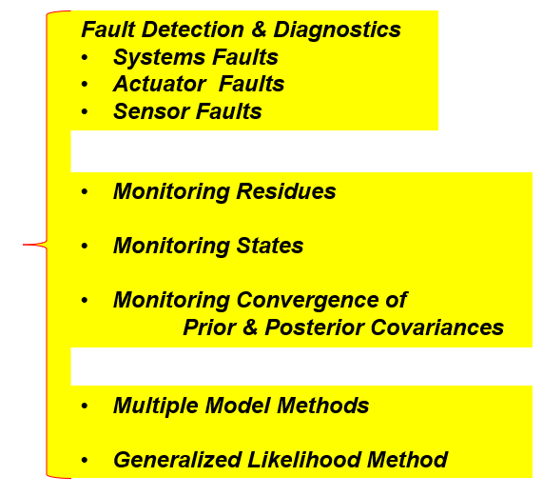
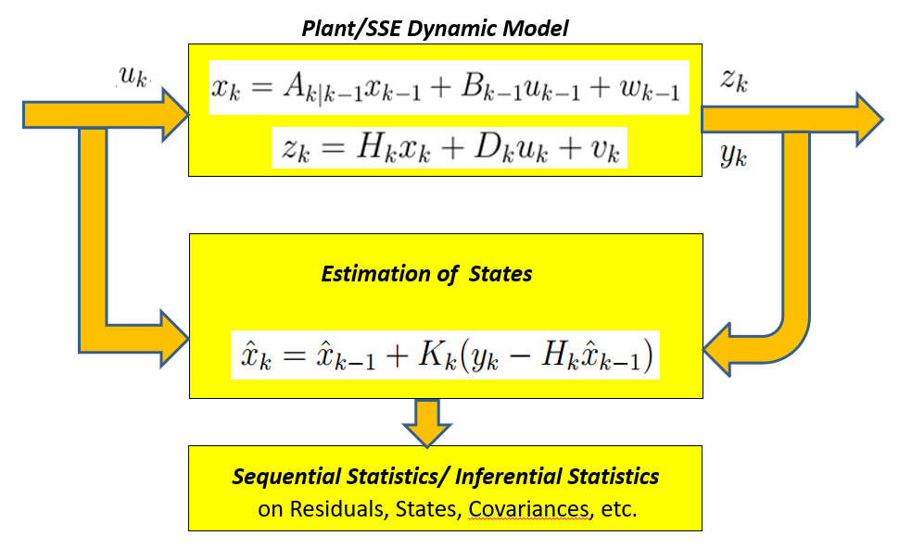
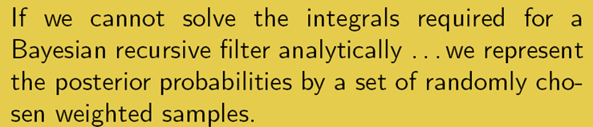
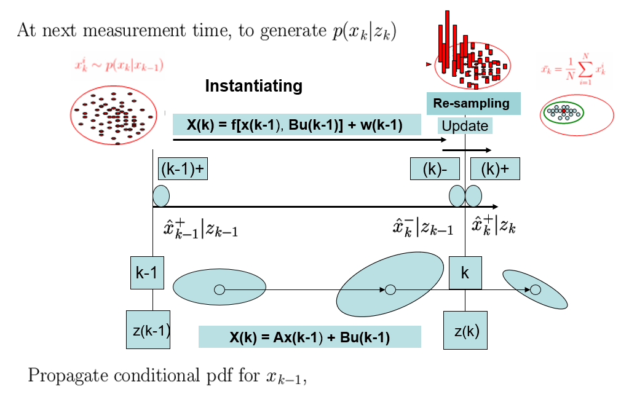
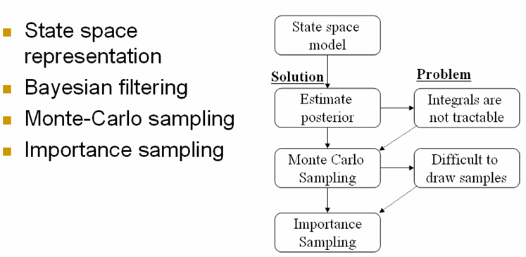
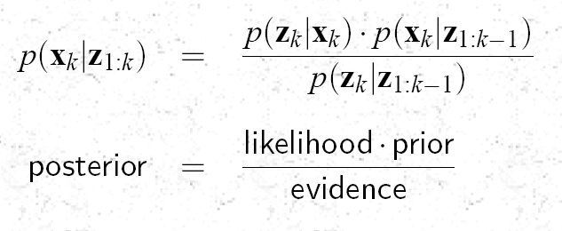
Review of Lecture 11-A : Why Non-Linear Estimation ? --- Why Sequential Monte Carlo?
Predictive Maintenance
Linearization
Extended Kalman Filtering

Slide 2
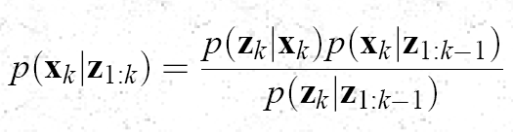


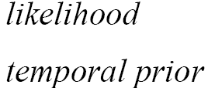

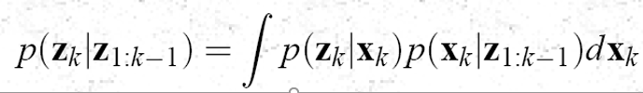
The Bayesian Posterior

Slide 3
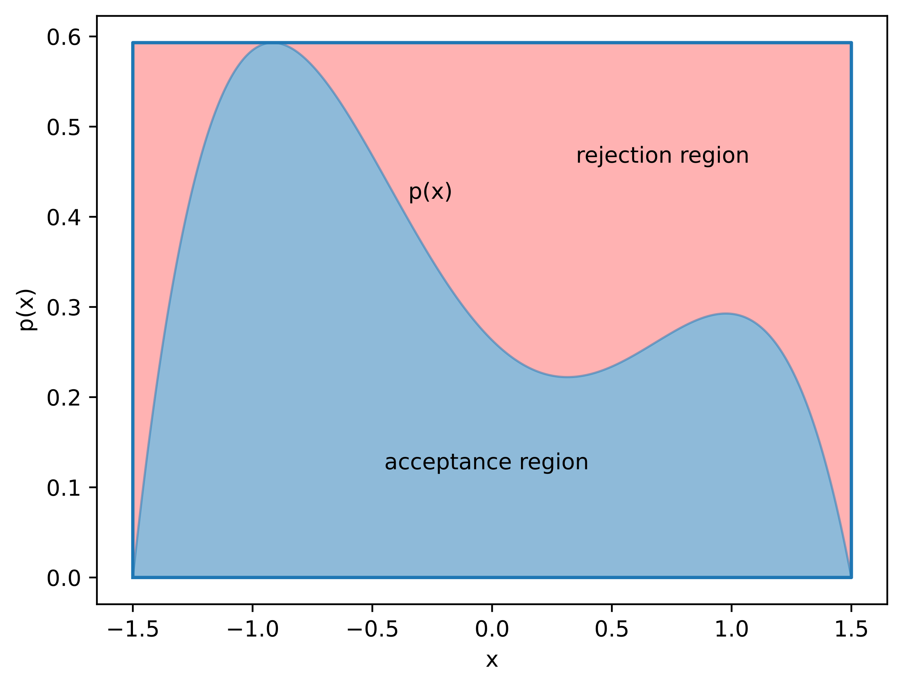
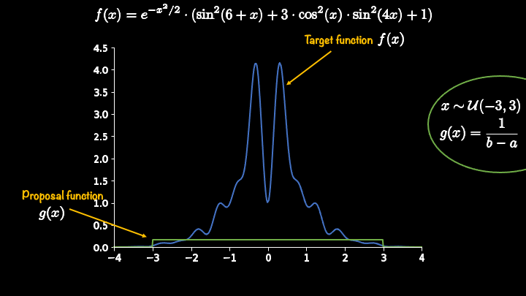
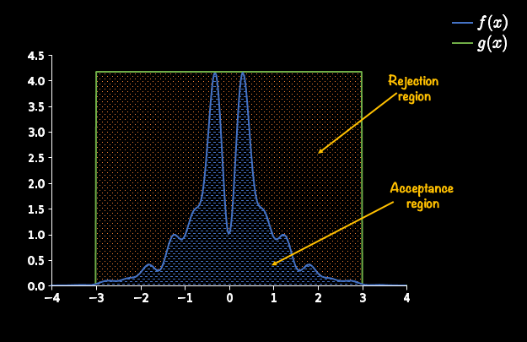
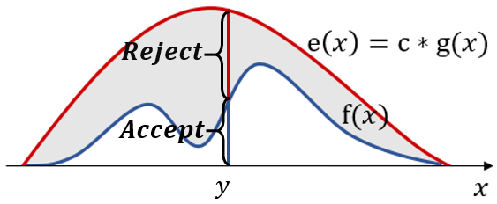
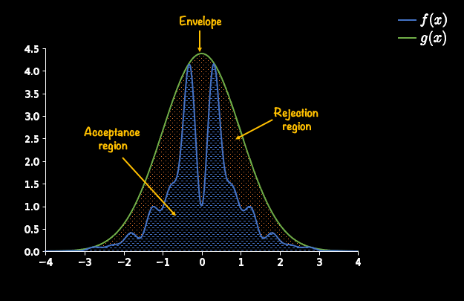
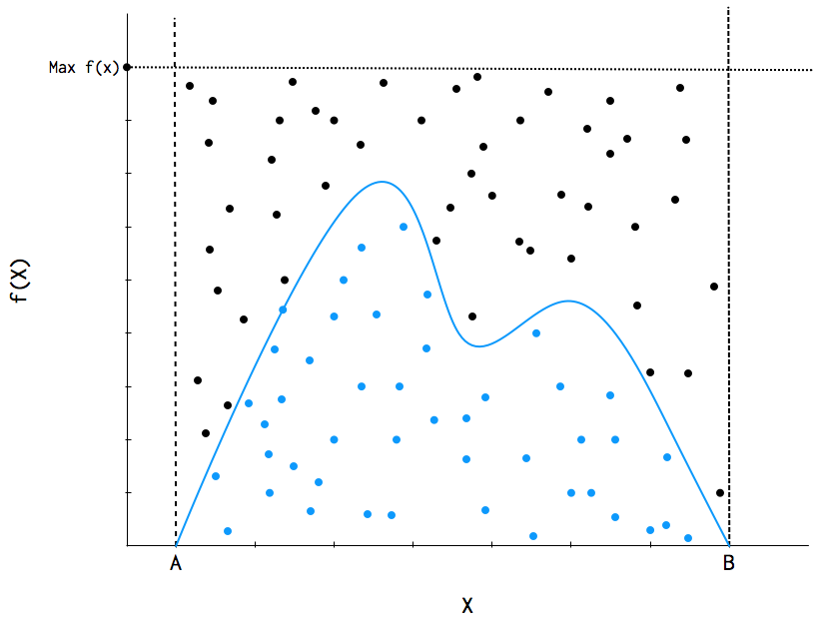
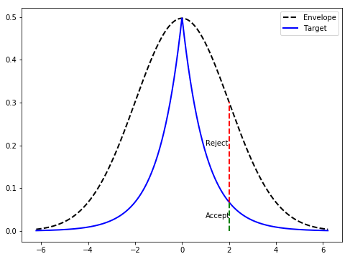
Rejection Sampling

Slide 4

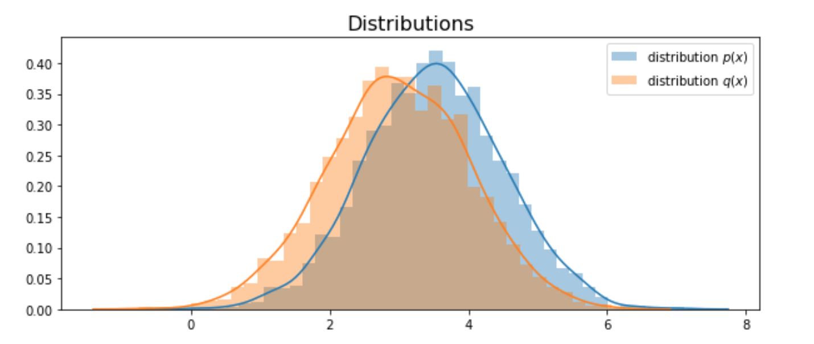
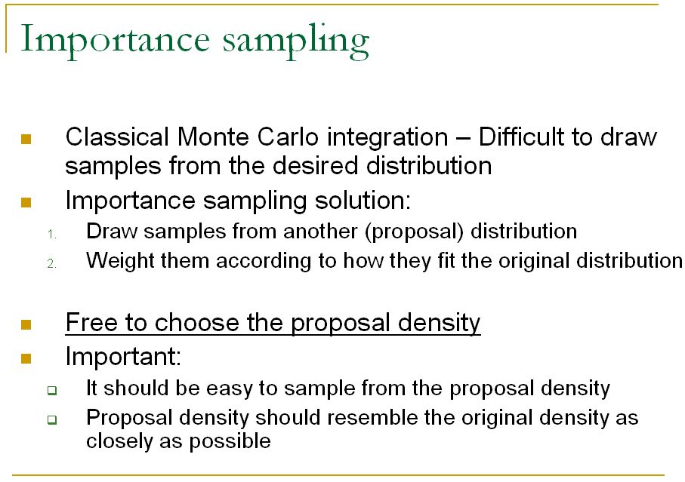
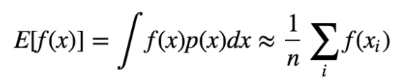
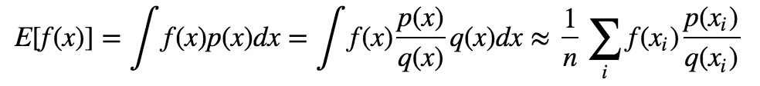

Slide 5
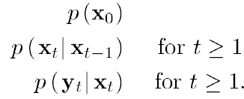

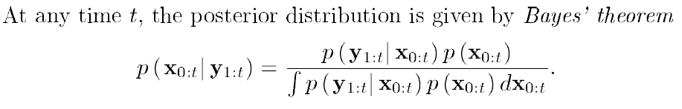

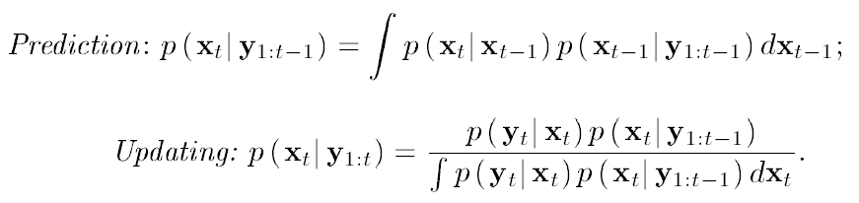
The Bayesian Approach for the Posterior

Slide 6
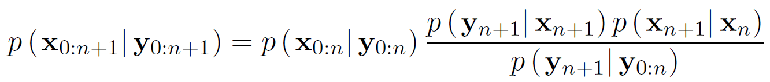
Recursive Posterior

Slide 7
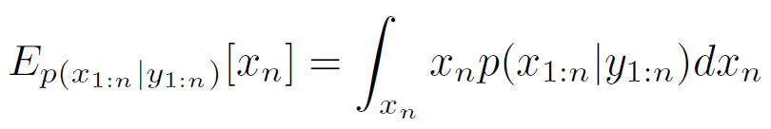
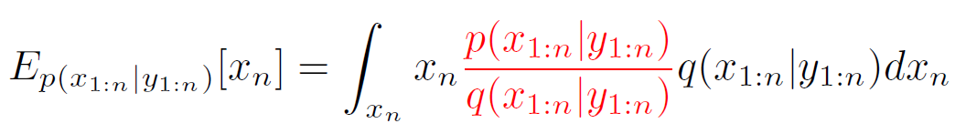

Importance Sampling & Weights

Slide 8
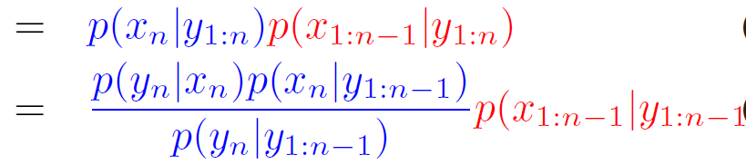
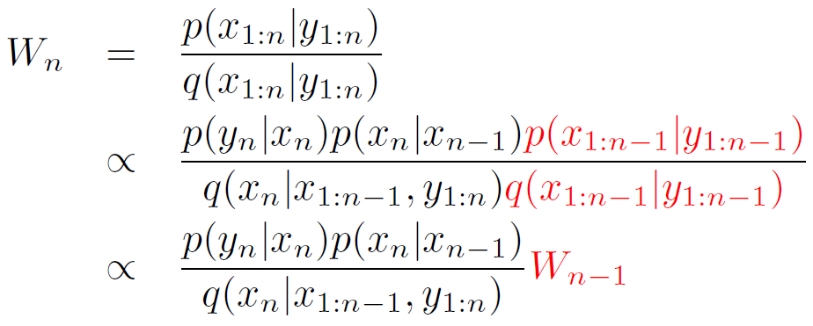
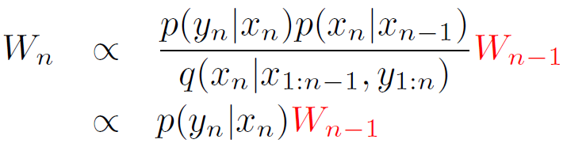
Weights & Likelihood Function

Slide 9
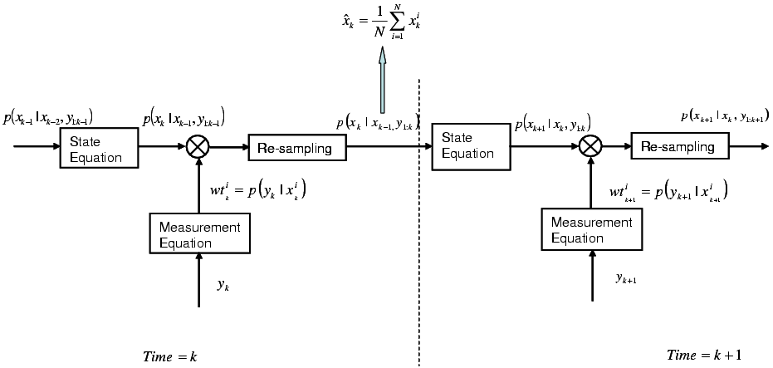
Sequential Importance Re-sampling/ Particle Filter

Slide 10
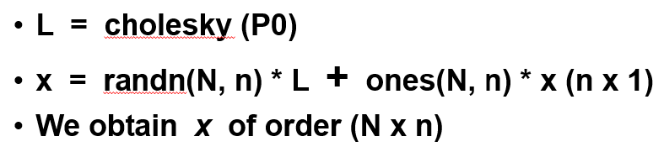
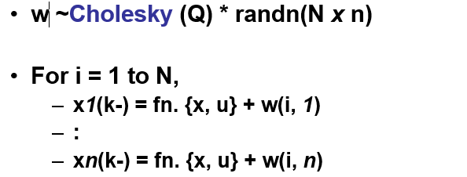
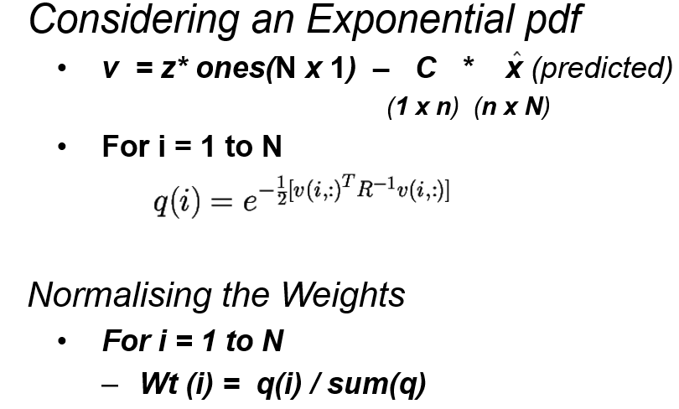
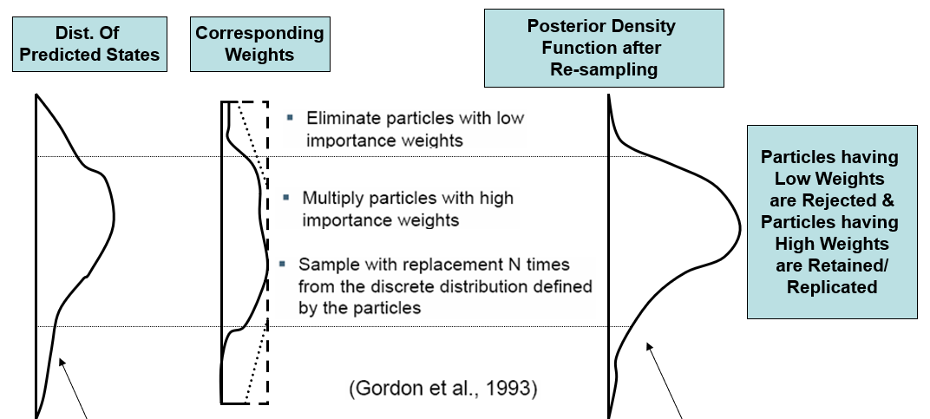
Implementation of the Particle Filter
Initialisation, t = 0; (Prior Step)
For i = 1, …., N, sample x(0) ~ p{x(0)} & set t = 1
Importance Sampling
Prediction Step
For i = 1,…,N, sample x(t,i) ~ p{x(t)|x(t-1, i)}
Likelihood Step
For i = 1,…,N, evaluate importance weights : w(t,i) = p{z(t)|x(t,i)
Normalise the Importance Weights
Selection
Update Step/Resampling Step
Resample with replacement, according to Importance Wts.
Set t = t + 1 and return to Prediction Step

Slide 11
Comparing Particle Filter and Kalman Filter
Kalman Filter
Guess/Prior Knowledge :
x(0), P(0), Q, R
Prediction/Propagation :
x(k-) = Ax(k-1+) + Bu(k)
P(k-) = AP(k-1+)A’ + Q
Update
r = z - cx
Obtaining Residues
K = …..
x(k+) = x( k-) + K.r
P(k+) = P(k-) – K…
Repeat for t = 1:T
Obtain Aposteriori Density
Particle Filter
Prior Knowledge : P(0), Q, R
Prior :
x(0) = fn. {Sqrt/Chol. (P(0) . randn}
(n x N) : N particles
Prediction :
For 1:N(particles)
x(k-) = Ax(k-1+) + Bu(k) + Q
Likelihood Function/ Importance
Wt. Generation (N)
pdf{[z – cx(k-1)], R} = Wts.(N)
Resampling (of the N Weights)
Repeat for t = 1: T
Obtain Aposteriori Density

